Slide 1

RESEARCH ON THE STRUCTURE OF OFFLINE HANDWRITTEN SIGNATURE VERIFICATION MODELS BASED ON TRANSFORMER
MASTER OF SCIENCE IN INTELLIGENT TECHNOLOGY (MII) THESIS PROPOSAL
Speaker：Mingchen Wang Supervisor: Xin Liu
Date：2024.11.13.

Slide 2

Contents
01
Research Background
02
Research Objectives and Significance
03
Literature Review
04
Methods and Data Sources
05
Existing and Expected Results

Slide 3
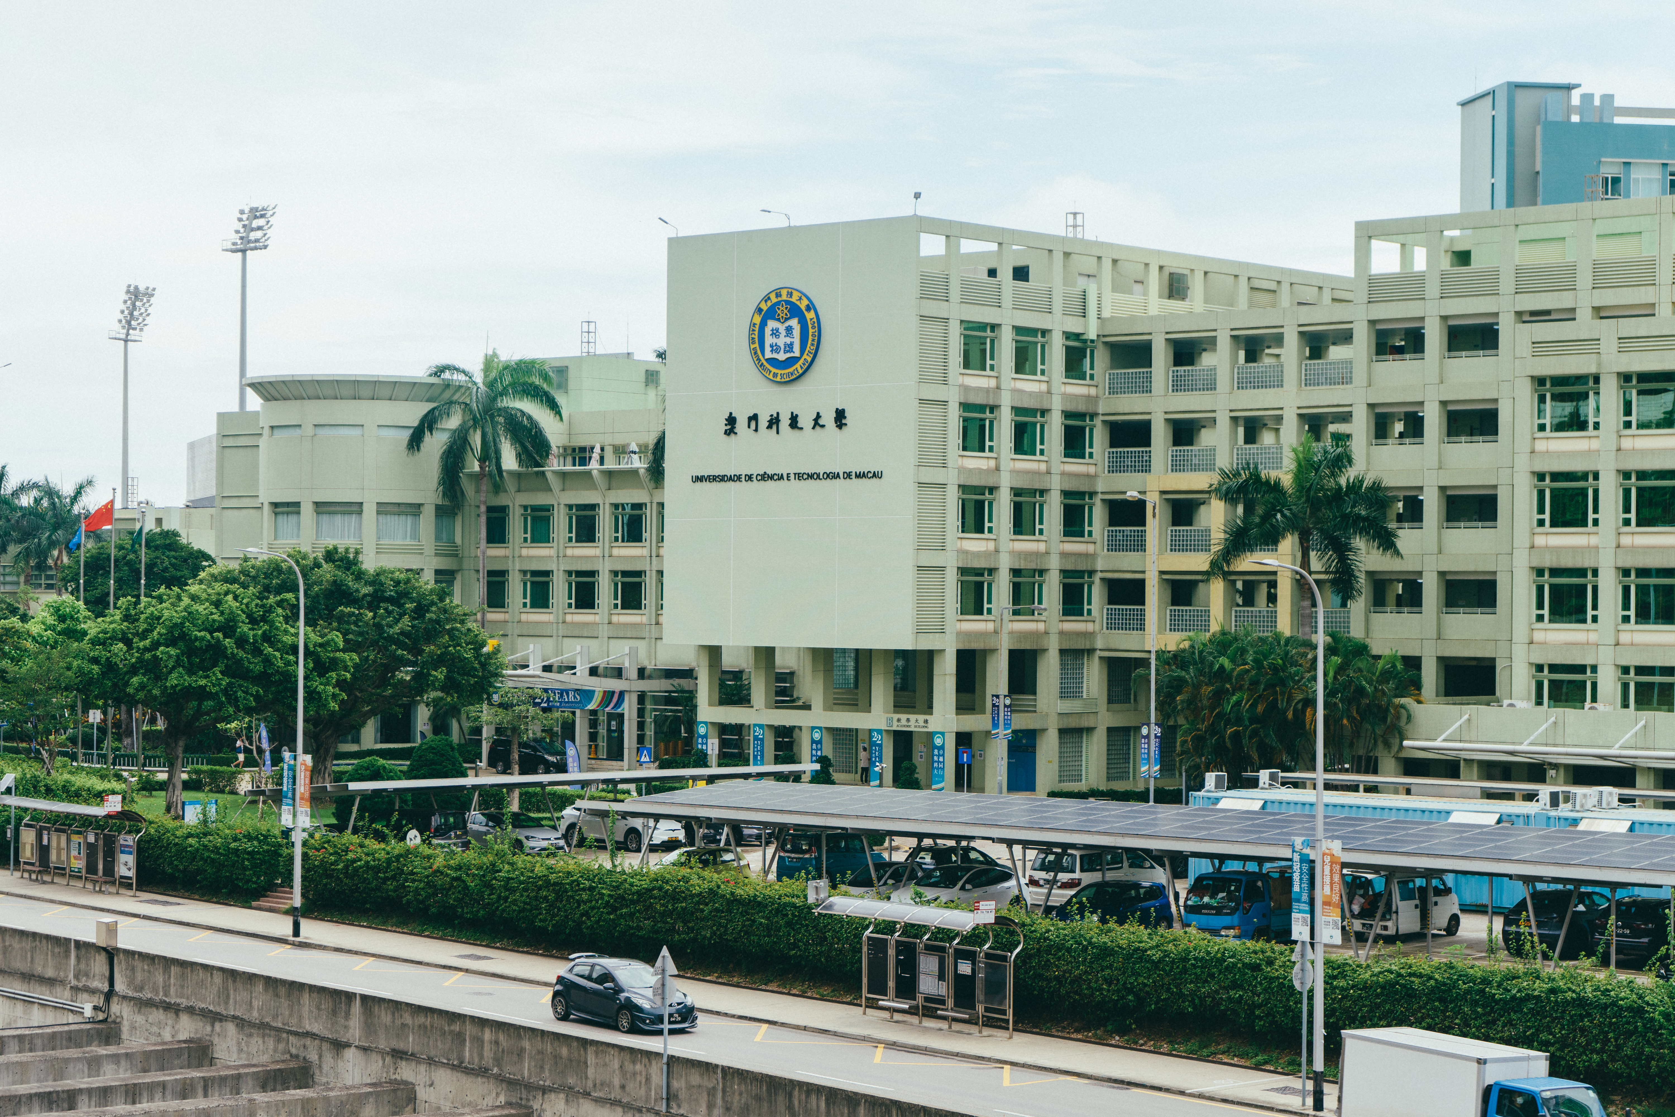
Research Background
01

Slide 4





Research Background
Handwritten
iris
Refers to the unique physical characteristics of each person's handwriting.
The flat, circular membrane in the middle layer of the eyeball
Voiceprints
Fingerprint
Biometrics Technology
It is a sound wave spectrum that carries speech information displayed by electroacoustic instruments
Fingerprints are the lines formed by the bumps on the skin at the end of human fingers.
Gait
Face
Gait refers to the posture and behavior characteristics of a person when walking.
The face is composed of the five senses: eyes, ears, nose, mouth and cheeks, and is the most important image of the human body.
Notes:
生物特征技术常用特征

Slide 5
Research Background
Identification
In this scenario, users only need to provide samples of their individual or physiological characteristics, and the biometric system identifies the user who provides the characteristics among the registered users based on the samples.
WHO?
Verification
In this scenario, is based on the identification scenario, where one declares one’s identity to the system, and then the system will verify whether any of the registered users is a designated user based on the above information.
YES/NO
Notes:
识别和验证

Slide 6

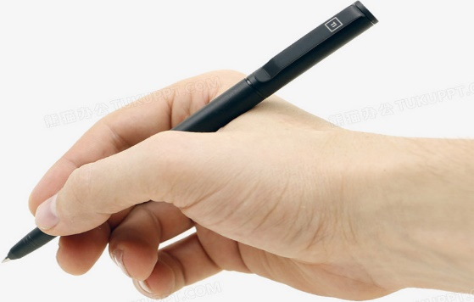

Research Background
01
Offline Signature Verification
Online Signature Verification
It has a personal signature collection process that is obtained through the user's writing process on paper.
It uses a digitizing station to collect the user's handwritten signature features, and thus The collected handwritten signature image may be affected by the device such as pen position, tilt, pressure etc.
02
Notes:
离线和在线区别

Slide 7
Research Background
Traditional Algorithm
Feature Extract
Multitasking
Machine Learning
Support Vector Machine
Hidden Markov Model
Manually Designed Feature
Writer-Dependent & Writer-Independent
Algorithm and model performance are extremely dependent on manually designed features.
Different data samples require targeted feature design, which takes a lot of time
Signature verification is divided into two tasks depending on whether there is a reference signature for comparison.
Notes:
研究动机
传统机器学习算法的准确率及其依赖人工设计的特征，而人工设计特征需要针对不同的数据样本定制特征值处理方法。
在离线手写签名验证中分为两种任务，需要针对两种任务再重新设计特种以用于验证。

Slide 8

02
Research Objectives and Significance

Slide 9
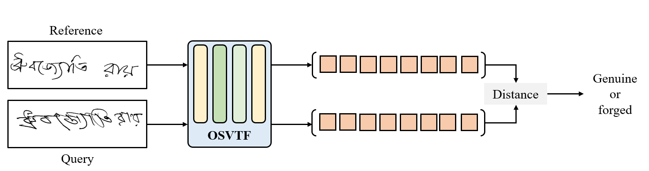
Research Objectives and Significance
Objectives
Phase 1. Reproduce OSV Model
Reproduce and analyze the existing newer OSV models, summarize the OSV model architecture details and characteristics.
Phase 2. Propose Model Structure
Combines the local feature learning capability of convolutional neural networks and the global feature learning capability of Transformer
Phase 3. Improve WD/WI Classifier
It is different from the final output part of image classification, so the SVM method may not be effective after new features are extracted.

Slide 10
Research Objectives and Significance
Better verification accuracy
1
Able to find ways to improve the existing offline handwritten signature verification model, so as to construct a model with better performance
Save cost on designing features
2
Save a lot of manual design costs for image features on different data samples, so that you can focus more on core algorithms and implementation work
Better infer costs
3
Ability to use less computing resources, thereby achieving efficient verification rate to complete more work
Promote the development of OCR
4
In OCR technology, image features are extracted to carry out related recognition work.
Notes:
研究意义

Slide 11

Literature Review
03

Slide 12
Literature Review
2017. L. G. Hafemann, G. M. Almeida
“Deep CNN based on transfer learning”
2019. W. Zhang, Z. Zhao
“Siamese network based on contrastive loss”
2020. E. Soleimani, M. Choraś
“Evaluated CNN、Siamese Network、GAN, and proposed a model combining GAN and Siamese network”
1989. R. Plamondon, M. Parizeau
“Geometric features & Euclidean distance”
1991. R. Kashi, M. Davidson
“Comparing the geometric features”
2000. J. Coetzer, A. Conradie
“Combining discrete Radon transform & HMM”
2003. C. Vielhauer, A. Mansfiel
“Fusing DWT with features”
2006. M. A. Hafemann, G. M. Almeida “Geometric features and fixed-point”
Early feature-based template matching methods
(1980s – Early 1990s)
Statistical Models and Machine Learning Methods (2000s - Early 2010s)
End-to-end systems based on deep neural networks
(Late 2010s - Present)
Structural features and texture analysis methods
(1990s - Early 2000s)
Introduction of deep learning methods
(Mid - 2010s)
Self-supervised learning and multimodal fusion
(2020 - Future)
1997. E. Justino, F. Bortolozzi
“HMM and SVM”
1998. R. Sabourin, M. Genest
“Wavelet transform”
2012. L. G. Hafemann, G.M. Almeida
“Convolutional Neural Networks”
2014. A. Jain, A. Ross
“Siamese Network”
2021. H. Kim, J. Lee
“Self-supervised learning”
2022. M. H. Siddiqi, M. Petti
“Multimodal signature verification method”
2024. Huan Li, Ping Wei
“Offline Signature Verification with Transformer”
Notes:
1. 早期基于特征的模板匹配方法 (1980年代 - 1990年代初)
1989年：Plamondon, R.,和Parizeau, M. 提出了一种基于几何特征的手写签名验证方法。他们在论文《A Signature Verification System Using Dynamic Features》中研究了基于几何特征和欧几里得距离的验证方法。这些早期方法关注于签名的整体形状、笔画粗细和斜度等基本特征。
1991年：Kashi, R.,和Davidson, M. 在《Signature verification through shape matching》中提出了一种基于形状匹配的手写签名验证方法。该方法主要通过比较签名的几何特征来实现签名的匹配。
2. 结构特征与纹理分析方法 (1990年代 - 2000年代初)
1997年：Justino, E.,和Bortolozzi, F. 在论文《A comparison of SVM and HMM classifiers in offline signature verification》中引入了隐马尔可夫模型（HMM）用于签名验证，利用签名的统计特征和结构特征进行匹配。
1998年：Sabourin, R.,和Genest, M. 提出了一种基于小波变换的签名验证方法，通过分解签名图像的频率特征，提高了验证系统对签名细节的感知能力。
3. 统计模型与机器学习方法 (2000年代 - 2010年代初)
2000年：Coetzer, J.,和Conradie, A. 在《Offline Signature Verification Using the Discrete Radon Transform and a Hidden Markov Model》中提出了使用离散Radon变换和隐马尔可夫模型（HMM）结合的方法，通过HMM的序列建模能力，更好地适应了签名样本的差异。
2003年：Vielhauer, C.,和Mansfield, A. 发表了论文《Offline Signature Verification Using DWT and Feature Fusion》，提出了将离散小波变换（DWT）与特征融合的方法。他们的研究结果表明，结合纹理和几何特征可有效提高签名验证的准确性。
2006年：Ferrer, M. A.,和Alonso, J. B. 在《Offline Geometric Parameters for Automatic Signature Verification Using Fixed-Point Arithmetic》中提出了一种基于几何特征和固定点运算的验证方法，使得该系统在资源受限的环境中运行更加高效。
4. 深度学习方法引入 (2010年代中期)
2012年：Hafemann, L. G.,和Almeida, G. M. 在《Offline handwritten signature verification using convolutional neural networks》中首次将卷积神经网络（CNN）引入到离线签名验证任务中。该方法能够自动学习签名的高级特征，不再依赖于手工特征提取。
2014年：Jain, A.,和Ross, A. 在《Learning feature representations for online handwritten signature verification using Siamese networks》中提出了基于孪生网络（Siamese Network）的验证方法。该方法通过度量学习来测量签名图像之间的相似度，从而提高了模型的鲁棒性和准确性。
5. 基于深度神经网络的端到端系统 (2010年代后期 - 现在)
2017年：Hafemann, L. G.,和Almeida, G. M. 在《Learning features for offline handwritten signature verification using deep convolutional neural networks and transfer learning》中提出了一种基于迁移学习的深度卷积神经网络（CNN）方法。该方法利用预训练模型进行特征提取，并通过迁移学习进一步优化模型，提高了系统在小数据集上的泛化能力。
2019年：Zhang, W.,和Zhao, Z. 在《Offline Signature Verification Using Siamese Network with Contrastive Loss》中提出了基于对比损失的孪生网络，通过优化损失函数，使网络能够更精确地区分真实签名和伪造签名。
2020年：Soleimani, E.,和Choraś, M. 在《A Comprehensive Study of Deep Learning Approaches for Offline Handwritten Signature Verification》中对各种深度学习模型进行了评估，包括卷积神经网络（CNN）、孪生网络（Siamese Network）和生成对抗网络（GAN），并提出了一种结合GAN和孪生网络的模型，用于生成伪造签名样本以增强训练数据集。
6. 自监督学习与多模态融合 (2020年 - 未来)
2021年：Kim, H.,和Lee, J. 在《Unsupervised Representation Learning for Handwritten Signature Verification》中提出了基于自监督学习的离线签名验证方法，使用SimCLR模型进行预训练，以减少对大量标注数据的依赖。
2022年：Siddiqi, M. H.,和Petti, M. 在《A Multi-Modal Approach for Offline and Online Signature Verification》中提出了多模态签名验证方法，将离线和在线签名数据结合，提高了模型的鲁棒性和适应性。

Slide 13
Literature Review
ResNet
ViT
AlexNet
Transformer
Deformable
2012
2016
2017
2021
2021
“ImageNet classification with deep convolutional neural networks”
“Deep Residual Learning for Image Recognition”
“Attention is All You Need”
“An Image is Worth 16x16 Words: Transformers for Image Recognition at Scale”
“Deformable DETR: Deformable Transformers for End-to-End Object Detection”

Slide 14
Methods and Data Sources
04

Slide 15
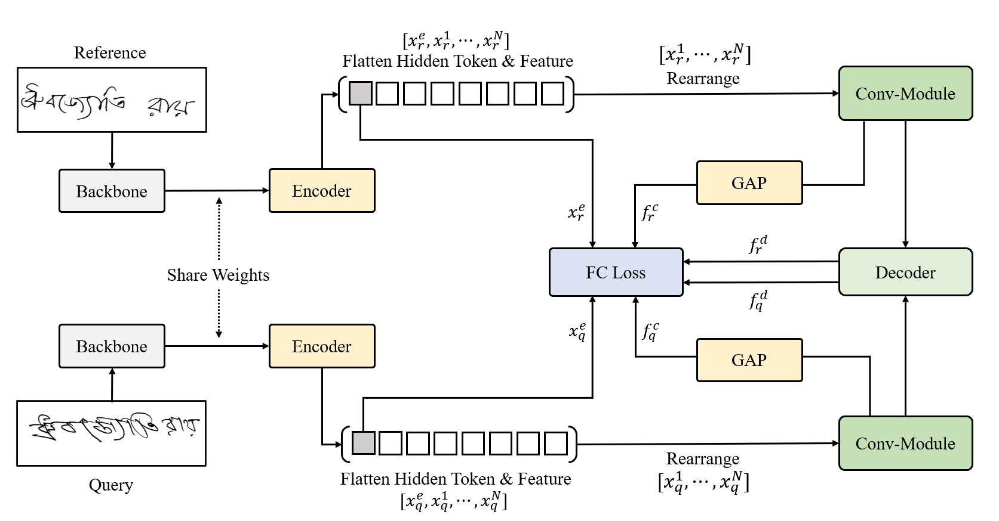
Methods and Data Sources
Offline Signature Verification TransFormer (OSVTF) Structure

Slide 16
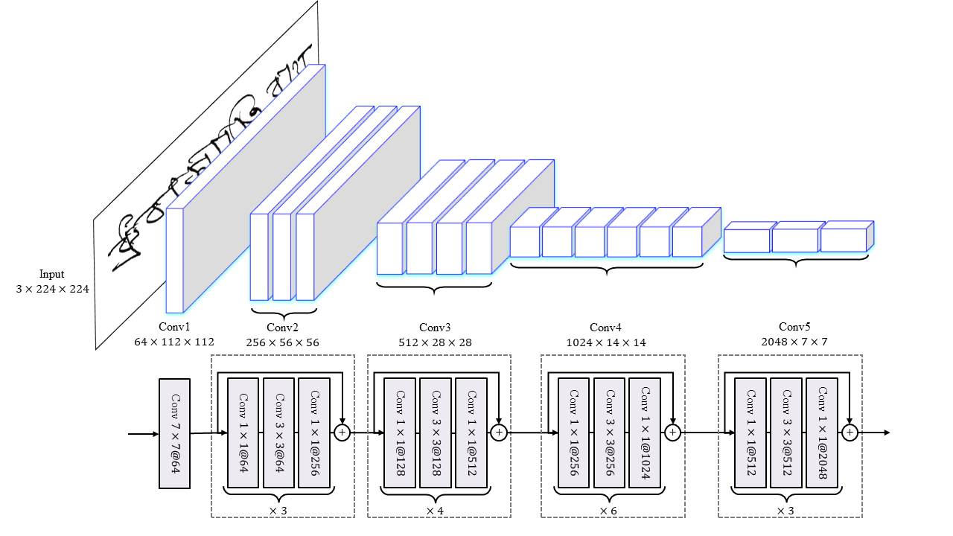
Methods and Data Sources
Backbone (e.g. ResNet-50)

Slide 17
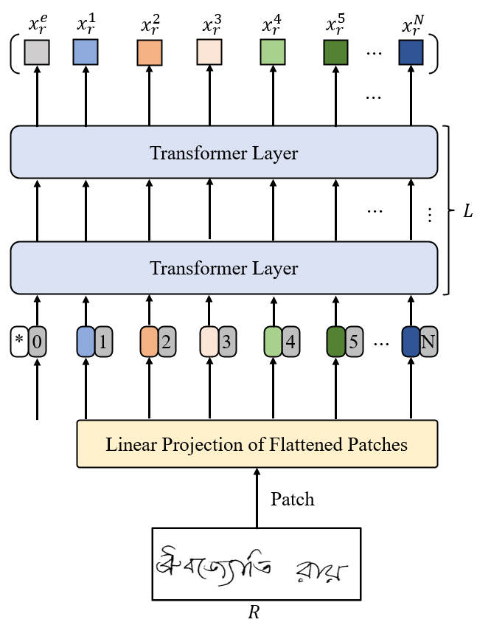
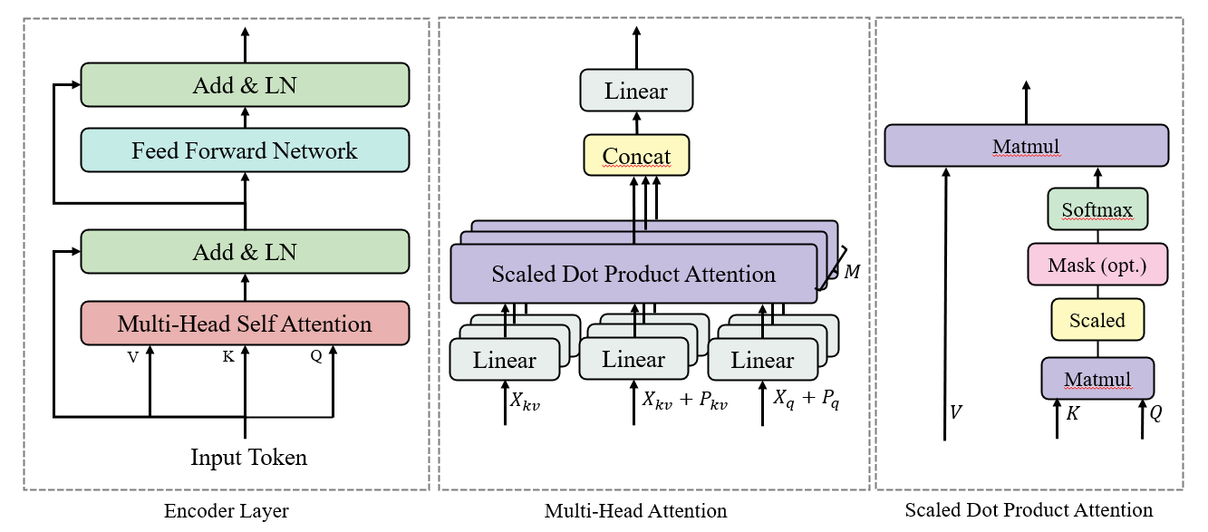
Methods and Data Sources
Encoder (ViT Encoder) & Multi-Head Attention

Slide 18
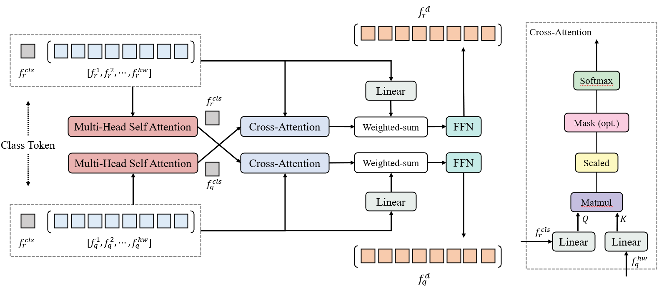
Methods and Data Sources
Decoder & Cross-Attention

Slide 19

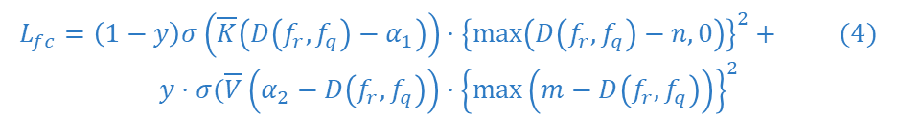
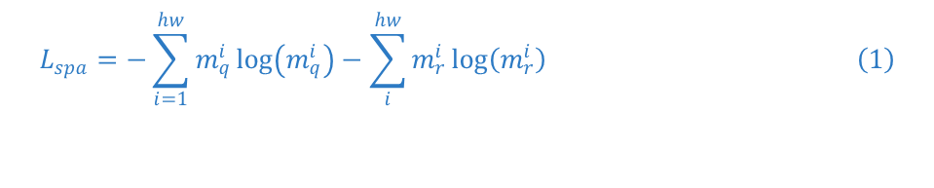

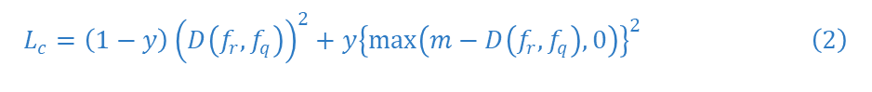
Methods and Data Sources
Loss Function
Sparsity Loss ($L_{spa}$)
$$L_{spa}=−\sum_{i=1}^{hw}{m_{q}^{i}\log\left(m_{q}^{i}\right)−\sum_{i}^{hw}{m_{r}^{i}\log\left(m_{r}^{i}\right)} } \left(1\right)$$
Focal Contrast Loss ($L_{fc}$)
$$L_{c}=\left(1−y\right){\left(D\left(f_{r}, f_{q}\right)\right)}^{2}+y{\left\{\max\left(m−D\left(f_{r}, f_{q}\right), 0\right)\right\}}^{2} \left(2\right)$$
$$L_{dm}=\left(1−y\right){\left\{\max\left(D\left(f_{r}, f_{q}\right)−n, 0\right)\right\}}^{2}+y{\left\{\max\left(m−D\left(f_{r},f_{q}\right),0\right)\right\}}^{2} \left(3\right)$$
$L_{fc}=\left(1−y\right)σ\left(\overline{K}\left(D\left(f_{r},f_{q}\right)−α_{1}\right)\right)⋅{\left\{\max\left(D\left(f_{r},f_{q}\right)−n, 0\right)\right\}}^{2}+ (4)$ $$y⋅σ(\overline{V}\left(α_{2}−D\left(f_{r}, f_{q}\right)\right)⋅{\left\{\max\left(m−D\left(f_{r}, f_{q}\right)\right)\right\}}^{2}$$
Notes:
[18] R. Hadsell, S. Chopra, and Y. LeCun, “Dimensionality reduction by learning an invariant mapping,” in Proceedings of the IEEE Computer Society Conference on Computer Vision and Pattern Recognition (CVPR), pp. 1735–1742, 2006.
[19] X. Lu, L. Huang, and F. Yin, “Cut and Compare: End-to-End Offline Signature Verification Network,” in Proceedings of the 25th International Conference on Pattern Recognition (ICPR), pp.176–183, 2021.
[20] T.-Y. Lin, P. Goyal, R. Girshick, K. He, and P. Dollár, “Focal Loss for Dense Object Detection,” IEEE Transactions on Pattern Analysis and Machine Intelligence, vol. 42, no. 2, pp. 318–327, 2020.

Slide 20
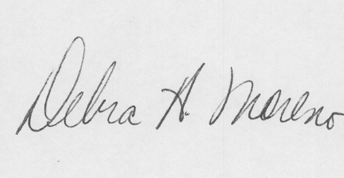
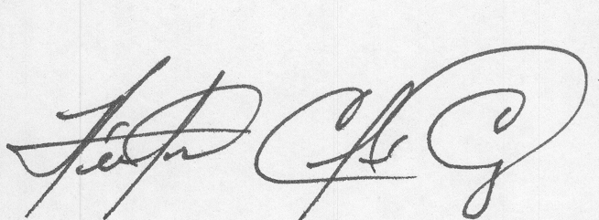
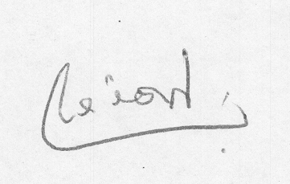
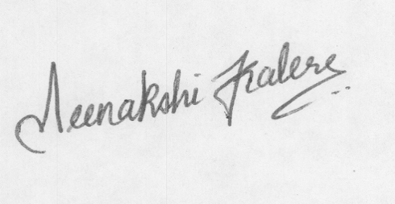


Methods and Data Sources
Dataset
BHSig-B (100) & BHSig-H (160)
CEDAR
$⋯$
(24 genuine & 30 forged)
$⋯$
(24 genuine & 24 forged)

Slide 21
05
Existing and Expected Results

Slide 22
Existing and Expected Results
Reproducible Model Evaluation
Model | FRR | FAR | EER
BHSig-B dataset (50/50)
SigNet | 13.89 | 13.89 | 13.89
CaP | 3.96 | 3.96 | 3.96
TransOSV [Base] | 11.26 | 11.26 | 11.26
My TransOSV [Reproduce] | 14.73 | 14.73 | 14.73
BHSig-H dataset (50/50)
SigNet | 15.36 | 15.36 | 15.36
CaP | 5.97 | 5.97 | 5.97
TransOSV [Base] | 7.89 | 7.89 | 7.89
My TransOSV [Reproduce] | 10.41 | 10.41 | 10.41

Slide 23
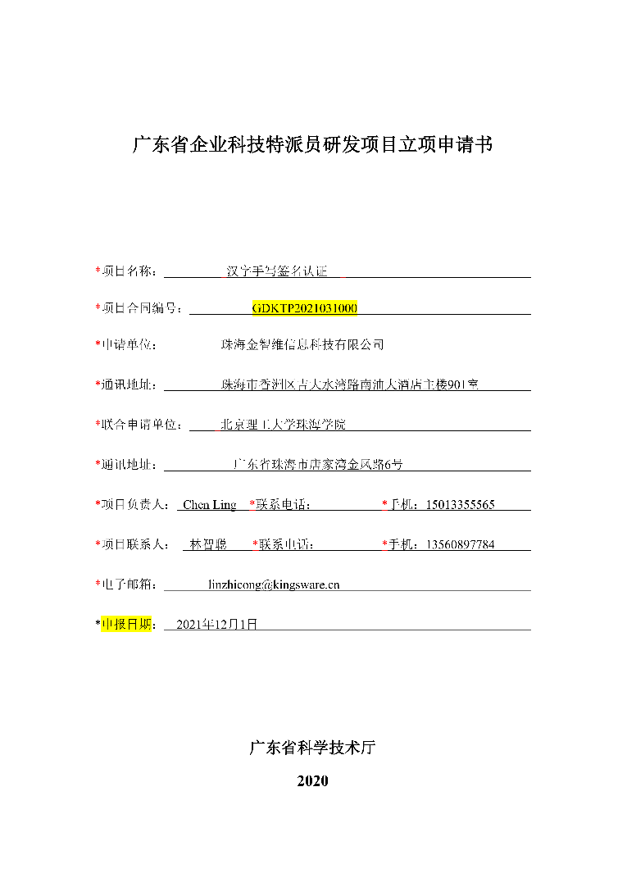
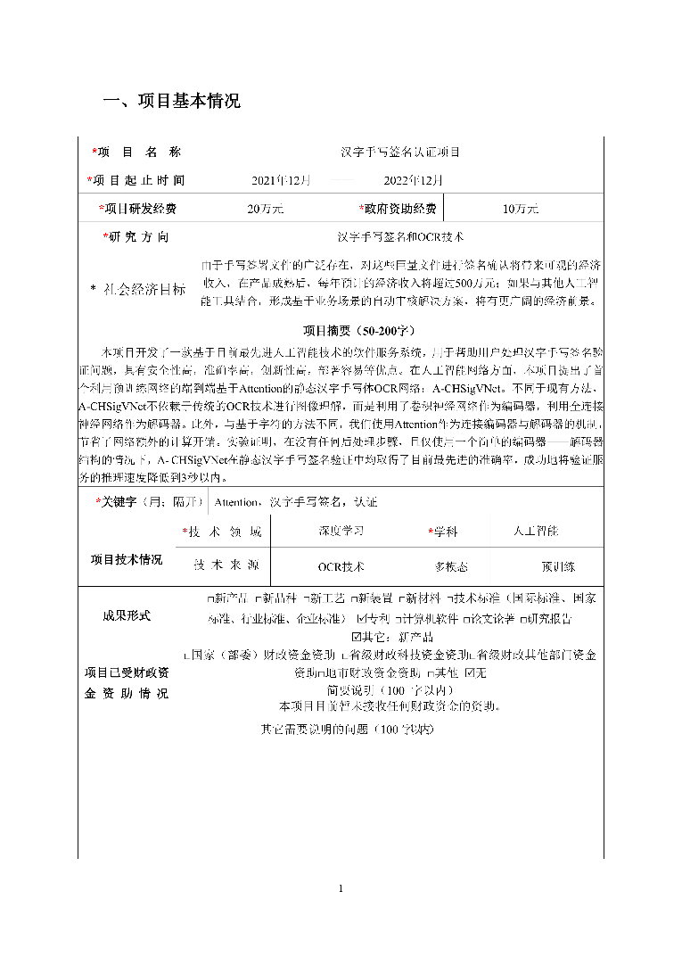
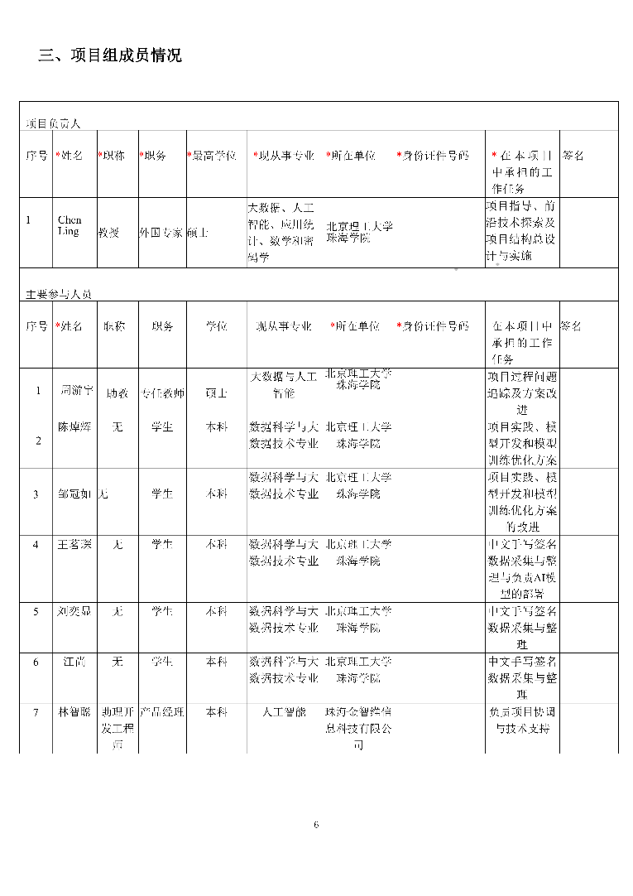
Existing and Expected Results
Company Cooperation Projects

Slide 24
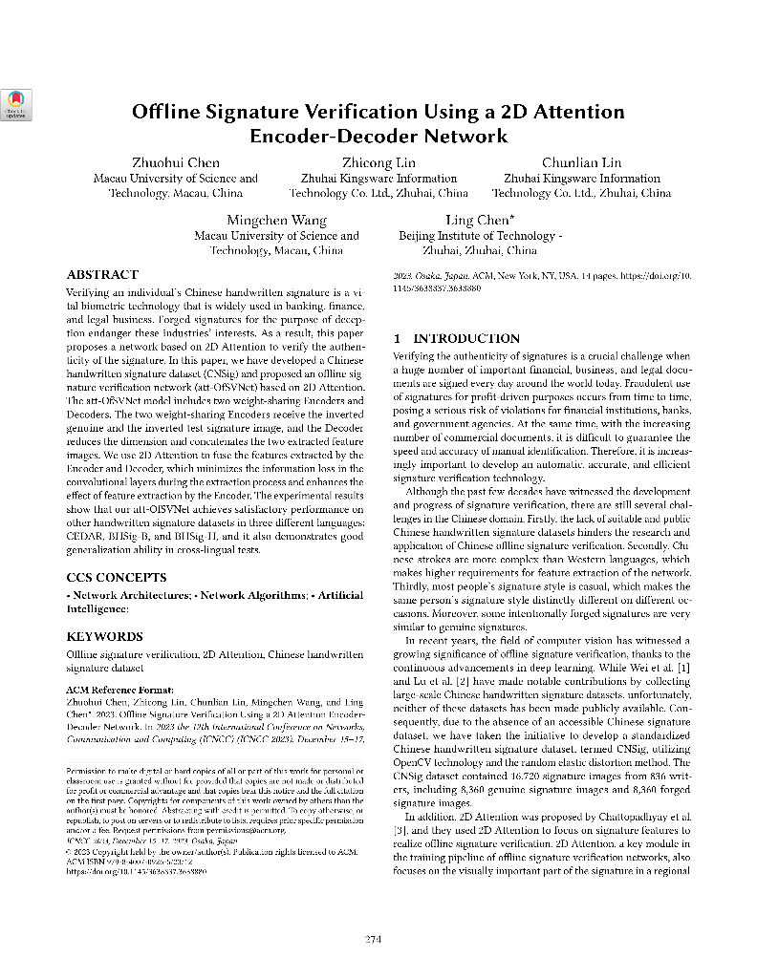
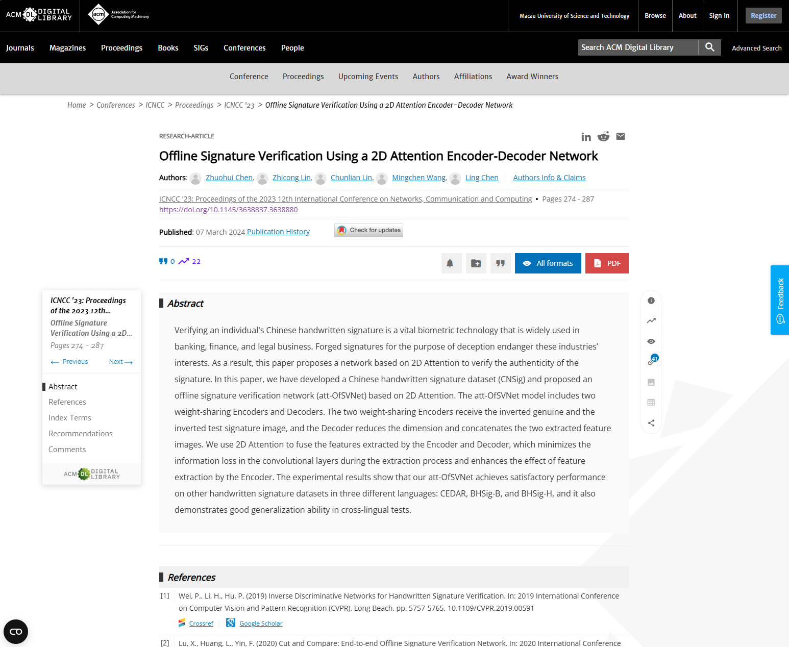
Existing and Expected Results
Published Papers
ICNCC-2023, ACM, 07 March 2024, DOI: 10.1145/3638837.3638880.

Slide 25
Existing and Expected Results
Current issues
Multi-Scale
Optimizing
Equipment
Introduce multi-scale feature maps on Backbone, Encoder and Decoder like Deformable DETR.
At present, there are certain defects in Encoder and Decoder.
Model training equipment is limited. (NVIDIA GeForce RTX 4070S*1)
Able to learn image features from multi-scale feature maps.
Optimizing ViT's 2D feature loss problem for image-to-flat features
Ability to input samples in large batches to learn model weights more efficiently.

Slide 26
Existing and Expected Results
Expected Results
Model Performance
Feature Extract
Expecting a Transformer-based model with higher accuracy.
A more novel method of image feature extraction can be provided, which can be applied to academic research in related image fields.
Company cooperation project income
The introduction of better models enables more benefits to be obtained in the deployment of related products

Slide 27
Thank you for listening.
Speaker：Mingchen Wang Faculty: Faculty of Innovation Engineering
Date：2024.11.13.

